Slide 1


MEME GENERATION USING AI
Created by
Name:Surya prakash.G
Reg.no.:-912321104049
3rd year CSE
Sacs mavmm engineering college

Slide 2

Project outline
Problem statement
Proposed system /solution
System development approach
Algorithm and deployment
Result
Conclusion
Reference

Slide 3
Problem statement
Develop an AI-powered meme generation system that can automatically create humorous and relatable memes using image and text processing techniques. The system should be capable of understanding various meme formats, generating relevant captions, and matching them with suitable images to produce engaging memes. Additionally, it should allow users to customize memes by providing input text or selecting from predefined templates. The goal is to create a platform that simplifies the meme creation process and produces high-quality memes that resonate with a wide audience.
◆

Slide 4
Proposed solution
CNN for Image Feature Extraction: Utilize a pre-trained CNN (e.g., ResNet, VGG) to extract features from meme images . Fine-tune the CNN on the meme dataset to capture specific meme-related features.
RNN for Text Processing: Use an RNN to process tokenized captions and capture sequential dependencies. Initialise the RNN with word embeddings to represent textual information in a continuous vector space.

Slide 5
Algorithm and deployment
Data Collection:
Gather a diverse dataset of memes, including images and corresponding captions, covering a wide range of popular meme formats and styles.
Preprocessing:
Clean and preprocess the dataset to remove noise, standardize text formats, and resize images for consistency.
Meme Generation Models:
Develop deep learning models such as convolutional neural networks (CNNs) and recurrent neural networks (RNNs) to generate memes.
Template Matching:
Implement algorithms to match generated captions with appropriate meme templates or image styles, ensuring coherence and relevance.
Deployment:
Deploy the meme generation system as a web or mobile application, making it accessible to a wide audience.

Slide 6
Algorithm and deployment (contd….)
Feedback Mechanism:
Incorporate feedback mechanisms to continuously improve meme generation accuracy and user satisfaction. Allow users to rate generated memes and provide feedback on their relevance and humor.
Monitoring and Maintenance:
Implement monitoring tools to track system performance, user engagement, and meme popularity. Regularly update the system with new meme formats, trending topics, and cultural references to keep it relevant and entertaining.

Slide 7
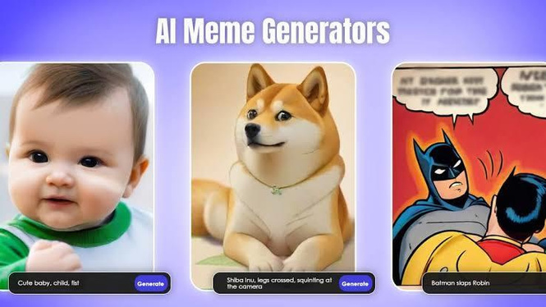
Result
Meme generation involves creating an image paired with a short, humorous caption to convey a message or idea in a visually appealing and engaging way. When generating a meme using AI for results, the focus is typically on showcasing the outcome or consequence of using AI technology
•

Slide 8
Conclusion
Meme generation using AI for conclusion involves creating a humorous or insightful image accompanied by a caption to summarize or draw a conclusion on a topic related to AI. The image chosen meme typically reflects the theme or idea being included, which could include depicted of people nodding in agreement, celebrating success, or expressing surprise

Slide 9
Reference
https://www.tensorflow.org/ https://numpy.org/ https://scikit-learn.org/stable/ https://keras.io/ https://matplotlib.org/

Slide 10


